Slide 1
Amit Patnaik
From asking AI
to building with it
A conversation about useful work
amitpatnaik.com
Chapter map
Notes:
ID M01. Module SHOW.
Cue: What have you made?.
Plain explanation: Begin with a product result, then ask: who has tried AI, used it where an error mattered, or made something another person could use? Take two responses.
Ask: Where has this appeared in your own work?
Source/limitation: https://amitpatnaik.com/
Navigation: next MAP; skip to M18. Pilot: core M01–M18; reserve follows M18. A 45–60 minute route can skip M08 and M12, and close at M18. Preserve the clinic.

Slide 2
Navigation
MAP
A visual route
01
The examples
02
The workspace
03
Build and try
04
Go deeper
Map
Close
2 / 27
Notes:
ID MAP. Module NAVIGATION.
Cue: Choose the next question.
Plain explanation: Use this chapter map to move with the room. The first route is M01–M18; deeper explanations follow after the close.
Ask: Where has this appeared in your own work?
Source/limitation: Amit’s account or conceptual teaching diagram; verify any live example before claiming it occurred.
Navigation: next M02; skip to M18. Pilot: core M01–M18; reserve follows M18. A 45–60 minute route can skip M08 and M12, and close at M18. Preserve the clinic.

Slide 3
Show
M02
My route
01
Communications
02
AI-assisted work
03
Useful products
Map
Close
3 / 27
Notes:
ID M02. Module SHOW.
Cue: Communications. Then building..
Plain explanation: Describe the route in your own words. The important change is applying domain knowledge and editorial judgement to software. Exact qualifications and dates are deliberately absent.
Ask: Where has this appeared in your own work?
Source/limitation: Amit’s account or conceptual teaching diagram; verify any live example before claiming it occurred.
Navigation: next M03; skip to M18. Pilot: core M01–M18; reserve follows M18. A 45–60 minute route can skip M08 and M12, and close at M18. Preserve the clinic.

Slide 4
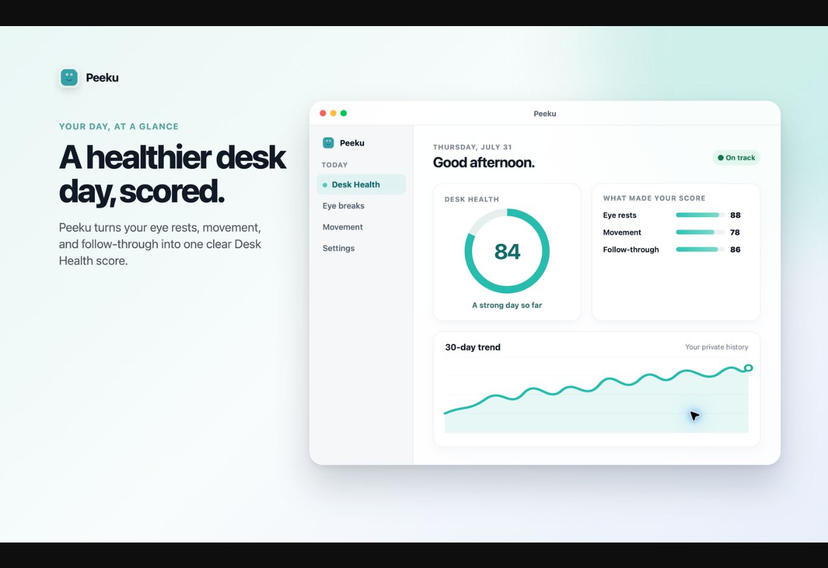
Show
M03
Peeku
A Mac utility born from a familiar need
Public product preview
Map
Close
4 / 27
Notes:
ID M03. Module SHOW.
Cue: A problem at my desk.
Plain explanation: Describe the desk problem and the behaviour you wanted. The visual is Peeku’s public promotional Mac preview, not a live application capture. For any lock behaviour, use a recording rather than the presenting Mac. Avoid unsupported dates or time-to-build claims.
Ask: Where has this appeared in your own work?
Source/limitation: https://peeku.app/assets/storefront/mac-01-desk-health-score.png
Navigation: next M04; skip to M18. Pilot: core M01–M18; reserve follows M18. A 45–60 minute route can skip M08 and M12, and close at M18. Preserve the clinic.

Slide 5
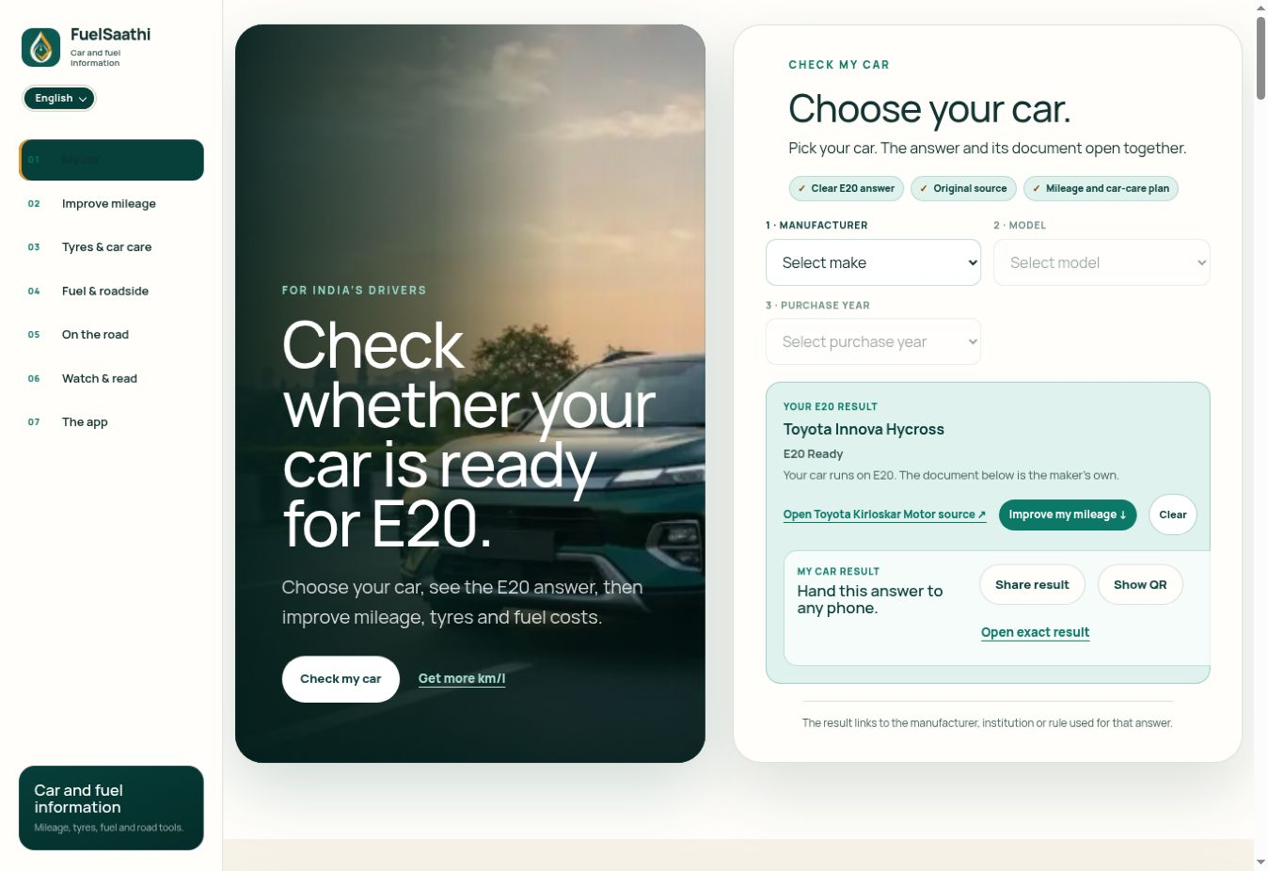
Show
M04
FuelSaathi
A public question, with a usable way to check
Public product website
Map
Close
5 / 27
Notes:
ID M04. Module SHOW.
Cue: A question in my own field.
Plain explanation: Briefly connect field knowledge, the user question and source-linked information. The website capture shows an already selected car from browser state; it is not fresh compatibility evidence. This is an independent product example. Do not imply ministry, manufacturer or oil-company endorsement.
Ask: Where has this appeared in your own work?
Source/limitation: https://fuelsaathi.com/
Navigation: next M05; skip to M18. Pilot: core M01–M18; reserve follows M18. A 45–60 minute route can skip M08 and M12, and close at M18. Preserve the clinic.

Slide 6
Show
M05
The backstage work
What you see
The result
What made it work
Brief Context Tools Attempts Checks
Map
Close
6 / 27
Notes:
ID M05. Module SHOW.
Cue: What you see / what made it work.
Plain explanation: The Prestige is an analogy for revealing the work behind a result. The lesson is the method. Do not imply that concealment or deception is part of good practice. This original diagram avoids a film asset with unclear redistribution rights.
Ask: Where has this appeared in your own work?
Source/limitation: Amit’s account or conceptual teaching diagram; verify any live example before claiming it occurred.
Navigation: next M06; skip to M18. Pilot: core M01–M18; reserve follows M18. A 45–60 minute route can skip M08 and M12, and close at M18. Preserve the clinic.

Slide 7
Explain
M06
We inherit explanations
A recipe preserves experience. The cook still needs judgement.
Map
Close
7 / 27
Notes:
ID M06. Module EXPLAIN.
Cue: Language carries knowledge.
Plain explanation: Offer this as Amit’s perspective: language carries reasoning, procedures and disagreement across generations. A model can learn broadly useful patterns from it. Written material does not capture all physical, social or tacit skill.
Ask: Where has this appeared in your own work?
Source/limitation: https://arxiv.org/abs/2005.14165
Navigation: next M07; skip to M18. Pilot: core M01–M18; reserve follows M18. A 45–60 minute route can skip M08 and M12, and close at M18. Preserve the clinic.

Slide 8
Explain
M07
Generating text
The answer depends on
the question
the context
Map
Close
8 / 27
Notes:
ID M07. Module EXPLAIN.
Cue: One piece, then the next.
Plain explanation: A typical autoregressive language model estimates a next token from available context, outputs it and repeats. The alternatives shown are illustrations, not measured probabilities. A token may be a fragment or punctuation, not a full word.
Ask: Where has this appeared in your own work?
Source/limitation: https://arxiv.org/abs/2005.14165
Navigation: next M08; skip to M18. Pilot: core M01–M18; reserve follows M18. A 45–60 minute route can skip M08 and M12, and close at M18. Preserve the clinic.

Slide 9
Explain
M08
Learning, using, remembering
01
Training changes the model
02
Inference uses it today
03
Memory may supply stored context
Map
Close
9 / 27
Notes:
ID M08. Module EXPLAIN.
Cue: Practice / today’s task / saved notes.
Plain explanation: Explain training as changing numerical settings, inference as applying the trained model, and memory as stored information that may be retrieved. A chat response alone is not proof the base model permanently changed. Stored does not mean currently in context.
Ask: Where has this appeared in your own work?
Source/limitation: https://arxiv.org/abs/2203.02155
Navigation: next M09; skip to M18. Pilot: core M01–M18; reserve follows M18. A 45–60 minute route can skip M08 and M12, and close at M18. Preserve the clinic.

Slide 10
Workspace
M09
My personal workspace
A question
Instructions
Project records
Relevant retrieval
Tools
Action rules
A result I can check
Map
Close
10 / 27
Notes:
ID M09. Module WORKSPACE.
Cue: My rules. My project records..
Plain explanation: Describe why repeated background, lost corrections and wrong voices led to an organised workspace. Present the components at a high level only; do not expose private Brain paths, records, credentials or health data.
Ask: Where has this appeared in your own work?
Source/limitation: Amit’s account or conceptual teaching diagram; verify any live example before claiming it occurred.
Navigation: next M10; skip to M18. Pilot: core M01–M18; reserve follows M18. A 45–60 minute route can skip M08 and M12, and close at M18. Preserve the clinic.

Slide 11
Workspace
M10
Connections and permission
01
Read a source
02
Propose an action
03
Approve and act
Map
Close
11 / 27
Notes:
ID M10. Module WORKSPACE.
Cue: Read is not send.
Plain explanation: MCP is a defined way for systems to expose tools and information. Having a connection does not mean blanket permission. Separate reading, writing and outward actions. An approval boundary must be real.
Ask: Where has this appeared in your own work?
Source/limitation: https://modelcontextprotocol.io/docs/getting-started/intro
Navigation: next M11; skip to M18. Pilot: core M01–M18; reserve follows M18. A 45–60 minute route can skip M08 and M12, and close at M18. Preserve the clinic.

Slide 12
Workspace
M11
Different work arrangements
01
Chat conversation
02
Connected workspace
03
Coding agent
04
Task-specific service
Map
Close
12 / 27
Notes:
ID M11. Module WORKSPACE.
Cue: Same question, different setup?.
Plain explanation: These are ways work can be arranged, not claims that every product runs the same model. A chat gives answers; a connected workspace retrieves records; a coding agent edits and checks files; a specialised service can return a narrow decision. They overlap.
Ask: Where has this appeared in your own work?
Source/limitation: Amit’s account or conceptual teaching diagram; verify any live example before claiming it occurred.
Navigation: next M12; skip to M18. Pilot: core M01–M18; reserve follows M18. A 45–60 minute route can skip M08 and M12, and close at M18. Preserve the clinic.

Slide 13
Explain
M12
A narrower decision task
Draft a support reply
Choose a support queue
Illustrative support task
Map
Close
13 / 27
Notes:
ID M12. Module EXPLAIN.
Cue: Write an answer / score the options.
Plain explanation: TypeSafe introduced Jev in September 2026 as a System One Model for constrained decisions. This synthetic example distinguishes composing a response from selecting or scoring defined options. Language models can also classify. No Jev run is claimed.
Ask: Where has this appeared in your own work?
Source/limitation: https://typesafe.ai/blog/introducing-system-one-models-and-jev
Navigation: next M13; skip to M18. Pilot: core M01–M18; reserve follows M18. A 45–60 minute route can skip M08 and M12, and close at M18. Preserve the clinic.

Slide 14
Workspace
M13
A voice that still sounds like you
Generic: We are delighted to announce an exciting workshop.
Grounded: Here is what we will work through, and why I find it useful.
Synthetic example
Map
Close
14 / 27
Notes:
ID M13. Module WORKSPACE.
Cue: Would I actually say this?.
Plain explanation: The two short lines are synthetic teaching examples. Add the actual audience, purpose, factual ledger and a short personal voice note to the brief. Ask what changed. No fake anecdote or detector evasion.
Ask: Where has this appeared in your own work?
Source/limitation: Amit’s account or conceptual teaching diagram; verify any live example before claiming it occurred.
Navigation: next M14; skip to M18. Pilot: core M01–M18; reserve follows M18. A 45–60 minute route can skip M08 and M12, and close at M18. Preserve the clinic.

Slide 15
Build
M14
Building with an agent
01
02
03
04
Useful brief
Working file
Executed check
Reviewable result
Map
Close
15 / 27
Notes:
ID M14. Module BUILD.
Cue: Describe. Build. Check..
Plain explanation: Walk through one project journey. The existence of a file does not prove it works; an executed check does not prove it is published. Discuss where human review belongs.
Ask: Where has this appeared in your own work?
Source/limitation: Amit’s account or conceptual teaching diagram; verify any live example before claiming it occurred.
Navigation: next M15; skip to M18. Pilot: core M01–M18; reserve follows M18. A 45–60 minute route can skip M08 and M12, and close at M18. Preserve the clinic.

Slide 16
Build
M15
The next version
01
02
03
Observed problem
Specific change
Repeat the check
Map
Close
16 / 27
Notes:
ID M15. Module BUILD.
Cue: What breaks next?.
Plain explanation: Use a genuine example of a bug or a release note if available during the live session. This slide uses a generic process because no specific revision record has been verified. No overnight-success claim.
Ask: Where has this appeared in your own work?
Source/limitation: Amit’s account or conceptual teaching diagram; verify any live example before claiming it occurred.
Navigation: next M16; skip to M18. Pilot: core M01–M18; reserve follows M18. A 45–60 minute route can skip M08 and M12, and close at M18. Preserve the clinic.

Slide 17
Try
M16
Your problem
Who needs it?
What can we use?
What should it produce?
How will we check?
Map
Close
17 / 27
Notes:
ID M16. Module TRY.
Cue: For whom? What result? How will we check?.
Plain explanation: Collect four or five ideas and choose one public or synthetic problem. Define the input, output, success check and approval boundary. Show one bounded attempt, one check and a revision.
Ask: Where has this appeared in your own work?
Source/limitation: Amit’s account or conceptual teaching diagram; verify any live example before claiming it occurred.
Navigation: next M17; skip to M18. Pilot: core M01–M18; reserve follows M18. A 45–60 minute route can skip M08 and M12, and close at M18. Preserve the clinic.

Slide 18
Try
M17
One task you can judge
01
Give a clear brief
02
Inspect the result
03
Save what worked
Map
Close
18 / 27
Notes:
ID M17. Module TRY.
Cue: A small first experiment.
Plain explanation: Start with a familiar task where the participant can judge quality. Progress to personal records and then narrow tools only when the use case demands them. Do not lead with subscription shopping.
Ask: Where has this appeared in your own work?
Source/limitation: Amit’s account or conceptual teaching diagram; verify any live example before claiming it occurred.
Navigation: next M18; skip to M18. Pilot: core M01–M18; reserve follows M18. A 45–60 minute route can skip M08 and M12, and close at M18. Preserve the clinic.

Slide 19

Try
M18
Continue afterwards
Explore the learning site
amitpatnaik.com/learn
Public examples and contact
amitpatnaik.com
Map
Close
19 / 27
Notes:
ID M18. Module TRY.
Cue: Examples and contact.
Plain explanation: Leave this screen visible for final questions. The QR encodes the displayed learning-site address. The site must be made public and checked from a signed-out browser before the audience receives it. The homepage remains a secondary path for examples and contact.
Ask: Where has this appeared in your own work?
Source/limitation: https://amitpatnaik.com/learn/ ; https://amitpatnaik.com/
Navigation: next M19; skip to M18. Pilot: core M01–M18; reserve follows M18. A 45–60 minute route can skip M08 and M12, and close at M18. Preserve the clinic.

Slide 20
Deeper
M19
Attention
The phone was beside the charger.
It was nearly empty.
What does “it” refer to?
Map
Close
20 / 27
Notes:
ID M19. Module DEEPER.
Cue: Which earlier pieces help?.
Plain explanation: The connection from “it” to “phone” is only a teaching aid. Transformer attention computes weighted combinations so information from positions can interact. This is not a measured attention map or a theory of consciousness.
Ask: Where has this appeared in your own work?
Source/limitation: https://arxiv.org/abs/1706.03762
Navigation: next M20; skip to M18. Pilot: core M01–M18; reserve follows M18. A 45–60 minute route can skip M08 and M12, and close at M18. Preserve the clinic.

Slide 21
Deeper
M20
Broad learning and job practice
Learn broad patterns from material
Practise useful task behaviour
Map
Close
21 / 27
Notes:
ID M20. Module DEEPER.
Cue: Pretraining / post-training.
Plain explanation: Pretraining fits broad patterns. Post-training uses demonstrations, preferences or reward signals to adapt behaviour. These describe stages of a model pipeline, not competing products.
Ask: Where has this appeared in your own work?
Source/limitation: https://arxiv.org/abs/2203.02155
Navigation: next M22; skip to M18. Pilot: core M01–M18; reserve follows M18. A 45–60 minute route can skip M08 and M12, and close at M18. Preserve the clinic.

Slide 22
Deeper
M22
Desk and filing cabinet
On the desk now
In the filing cabinet
Instructions and facts for this task
Records that may be brought in
Map
Close
22 / 27
Notes:
ID M22. Module DEEPER.
Cue: Today’s context / saved memory.
Plain explanation: Context is available for the present task. A stored record may be selected and brought in. Ask what was actually retrieved; an old preference may be wrong.
Ask: Where has this appeared in your own work?
Source/limitation: Amit’s account or conceptual teaching diagram; verify any live example before claiming it occurred.
Navigation: next M23; skip to M18. Pilot: core M01–M18; reserve follows M18. A 45–60 minute route can skip M08 and M12, and close at M18. Preserve the clinic.

Slide 23
Deeper
M23
Same request, different workspace
“Write a note about the event.”
“Use this audience, factual ledger and voice note. Flag gaps.”
Synthetic example
Map
Close
23 / 27
Notes:
ID M23. Module DEEPER.
Cue: What changed in the input?.
Plain explanation: Synthetic controlled teaching example. Keep model and factual question constant and vary the supplied context. Do not describe the outputs as a benchmark or claim measured superiority.
Ask: Where has this appeared in your own work?
Source/limitation: Amit’s account or conceptual teaching diagram; verify any live example before claiming it occurred.
Navigation: next M25; skip to M18. Pilot: core M01–M18; reserve follows M18. A 45–60 minute route can skip M08 and M12, and close at M18. Preserve the clinic.

Slide 24
Deeper
M25
The agent loop
01
02
03
04
Task
Tool call
Observed result
Next action
Map
Close
24 / 27
Notes:
ID M25. Module DEEPER.
Cue: Task. Tool. Observation. Next step..
Plain explanation: The agent iterates from a task to a tool observation and decides what to do next. When action is outward or irreversible, there is a real approval boundary. The observation must reflect what the tool returned.
Ask: Where has this appeared in your own work?
Source/limitation: Amit’s account or conceptual teaching diagram; verify any live example before claiming it occurred.
Navigation: next M29; skip to M18. Pilot: core M01–M18; reserve follows M18. A 45–60 minute route can skip M08 and M12, and close at M18. Preserve the clinic.

Slide 25
Deeper
M29
From files to a website
01
02
03
04
Project files
Preview
Public version
Domain
Map
Close
25 / 27
Notes:
ID M29. Module DEEPER.
Cue: Preview before public.
Plain explanation: A repository holds project history; a preview lets people inspect a change; deployment creates a public version; a domain points visitors to it. A preview is not proof that a public version is live.
Ask: Where has this appeared in your own work?
Source/limitation: Amit’s account or conceptual teaching diagram; verify any live example before claiming it occurred.
Navigation: next M31; skip to M18. Pilot: core M01–M18; reserve follows M18. A 45–60 minute route can skip M08 and M12, and close at M18. Preserve the clinic.

Slide 26
Deeper
M31
Git and proposed edits
01
02
03
04
Commit
Branch
Proposed change
Review
Map
Close
26 / 27
Notes:
ID M31. Module DEEPER.
Cue: Keep history and review a change.
Plain explanation: A commit records a state; a branch isolates work; a pull request proposes a change for review. A fork is a separate copy under another owner. Use the terms precisely.
Ask: Where has this appeared in your own work?
Source/limitation: https://docs.github.com/en/get-started/using-github/github-flow
Navigation: next M38; skip to M18. Pilot: core M01–M18; reserve follows M18. A 45–60 minute route can skip M08 and M12, and close at M18. Preserve the clinic.

Slide 27
Deeper
M38
Before an action
01
What was read?
02
What will change?
03
Who approves?
04
What proves completion?
Map
Close
27 / 27
Notes:
ID M38. Module DEEPER.
Cue: What will change? Who decides?.
Plain explanation: Use this when the group asks about privacy, errors or reliability. The exact records, authority and confirmation matter more than a generic claim of safety.
Ask: Where has this appeared in your own work?
Source/limitation: Amit’s account or conceptual teaching diagram; verify any live example before claiming it occurred.
Navigation: next close; skip to M18. Pilot: core M01–M18; reserve follows M18. A 45–60 minute route can skip M08 and M12, and close at M18. Preserve the clinic.

